Slide 1
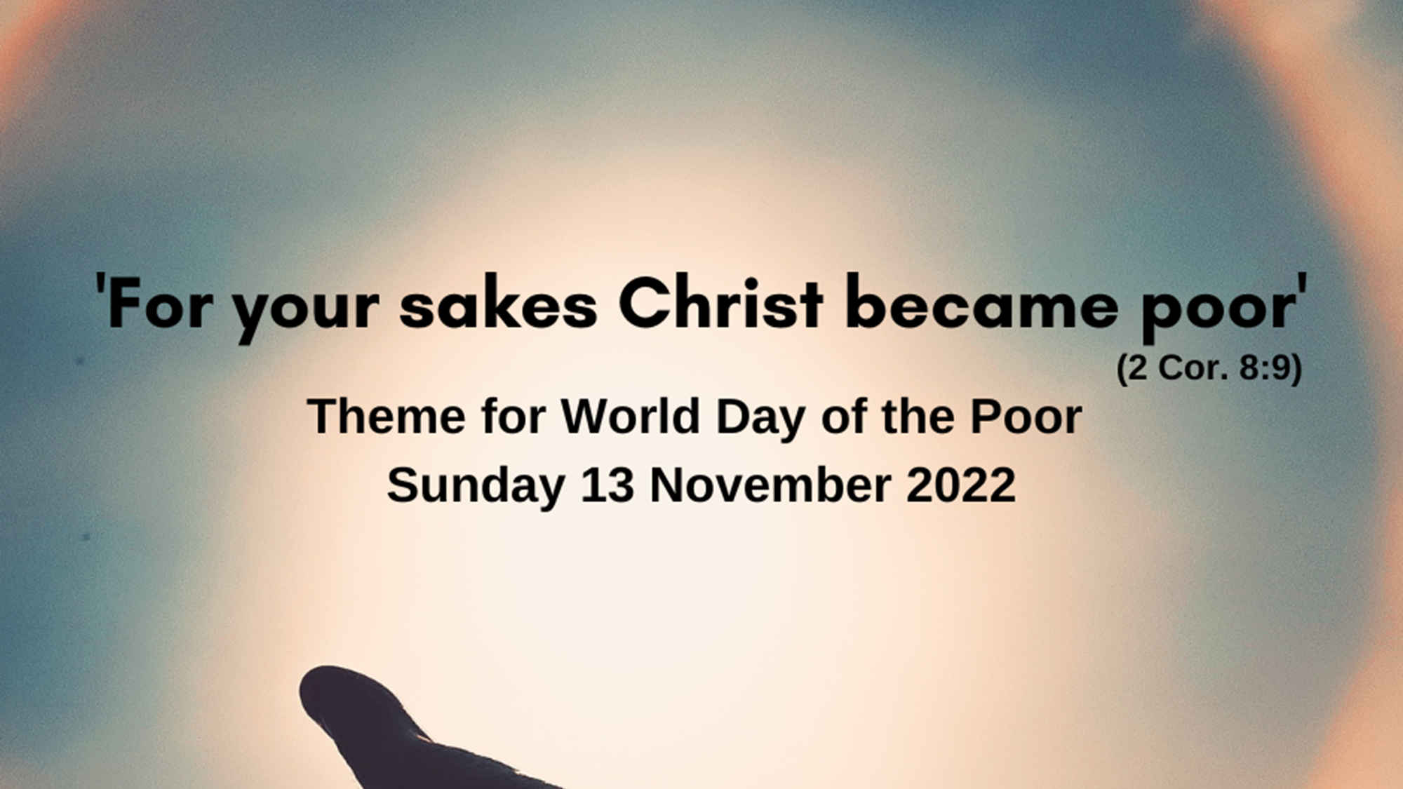

Slide 2
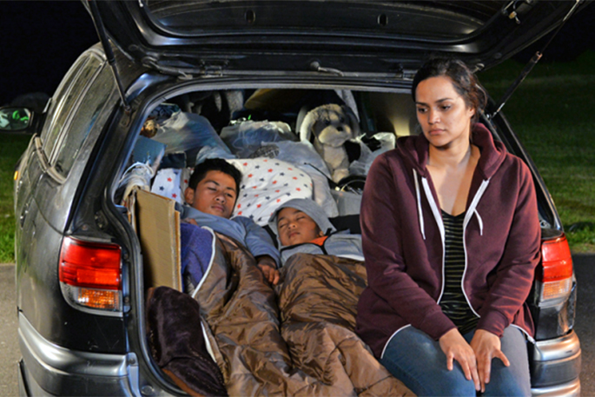
The World Day of the Poor comes this year as a healthy challenge, helping us to reflect on our style of life and on the many forms of poverty all around us.

Slide 3
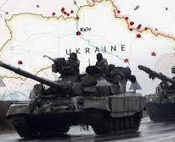
a new catastrophe has appeared on the horizon, destined to impose on our world a very different scenario.

Slide 4
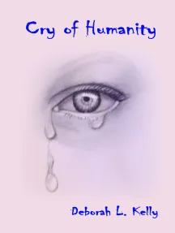
……demands made by a few potentates are stifling the voice of a humanity that cries out for peace.

Slide 5
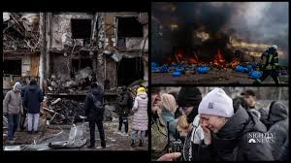
What great poverty is produced by the senselessness of war! Wherever we look, we can see how violence strikes those who are defenseless and vulnerable.

Slide 6
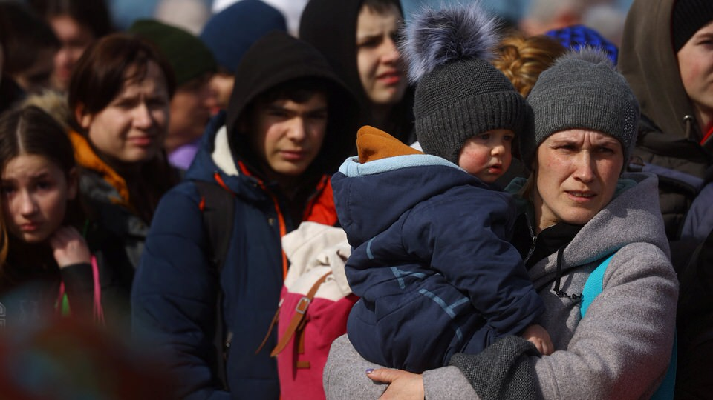
How can we respond adequately to this situation, and to bring relief and peace to all these people in the grip of uncertainty and instability?

Slide 7
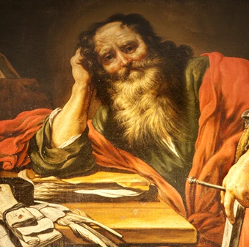
At Paul’s request, on every first day of the week they collected what they were able to save and all proved very generous.

Slide 8
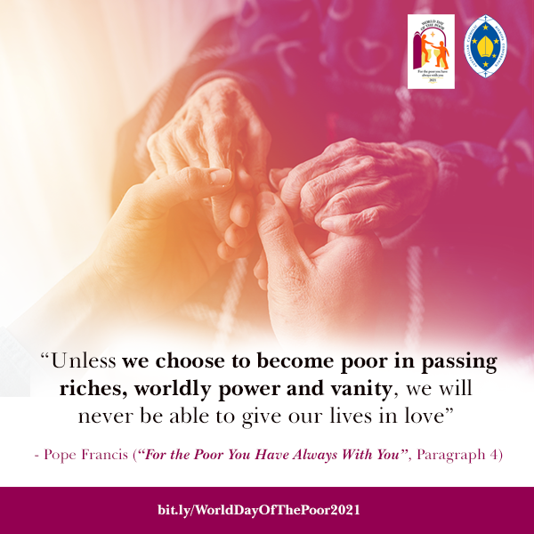
we have done the same thing, pooling our offerings so that the community can provide for the needs of the poor. It is something that Christians have always done with joy and a sense of responsibility, to ensure that none of our brothers or sisters will lack the necessities of life.

Slide 9
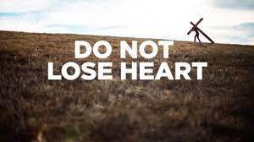
This is the moment for us not to lose heart but to renew our initial motivation. The work we have begun needs to be brought to completion with the same sense of responsibility.

Slide 10
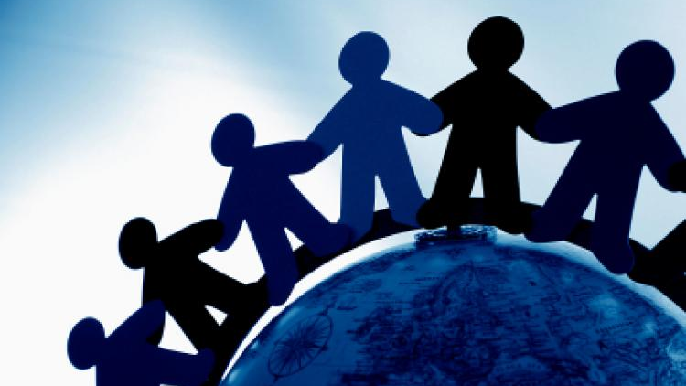
That, in effect, is precisely what solidarity is: sharing the little we have with those who have nothing, so that no one will go without. The sense of community and of communion as a style of life increases and a sense of solidarity matures.

Slide 11
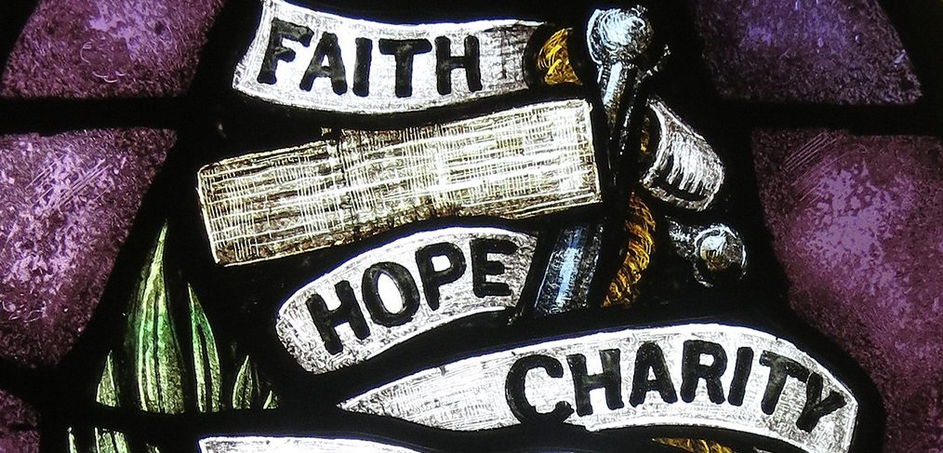
as Christians, let us always make charity, faith and hope the basis of our lives and our actions.

Slide 12
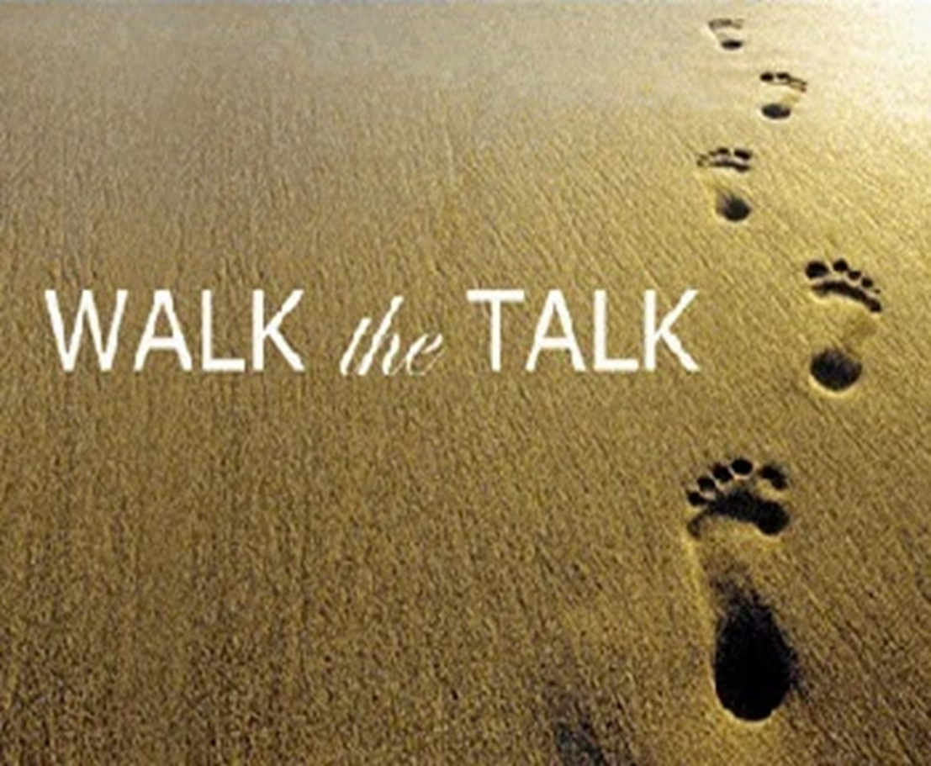
“Be doers of the word, and not merely hearers who deceive themselves..” James

Slide 13

it is not talk that matters; what matters is rolling up our sleeves and putting our faith into practice through a direct involvement, one that cannot be delegated

Slide 14
It is not activism that saves, but sincere and generous concern that makes us approach a poor person as a brother or sister who lends a hand to help me shake off the lethargy into which I have fallen.

Slide 15
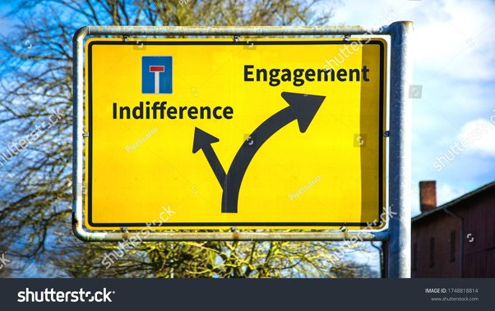
At times a kind of laxity can creep in that leads to indifference to the poor

Slide 16
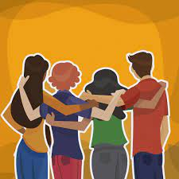
We need to find new solution that go beyond “policies for the poor

Slide 17

“I do not think there should be relief for others and pressure on you, but it is a question of fair balance”

Slide 18
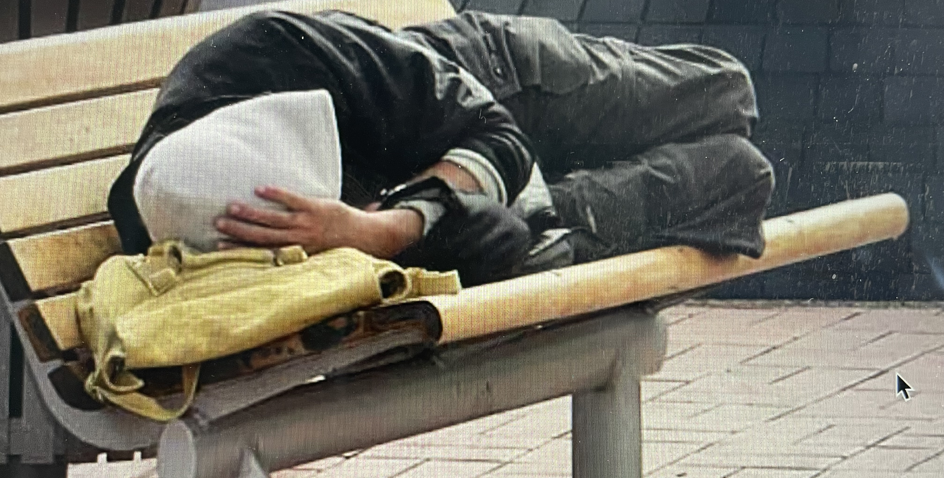
The poverty that kills is squalor, the daughter of injustice, exploitation, violence and the unjust distribution of resources

Slide 19
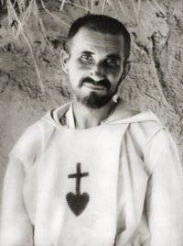
Brother Charles de Foucauld

Slide 20
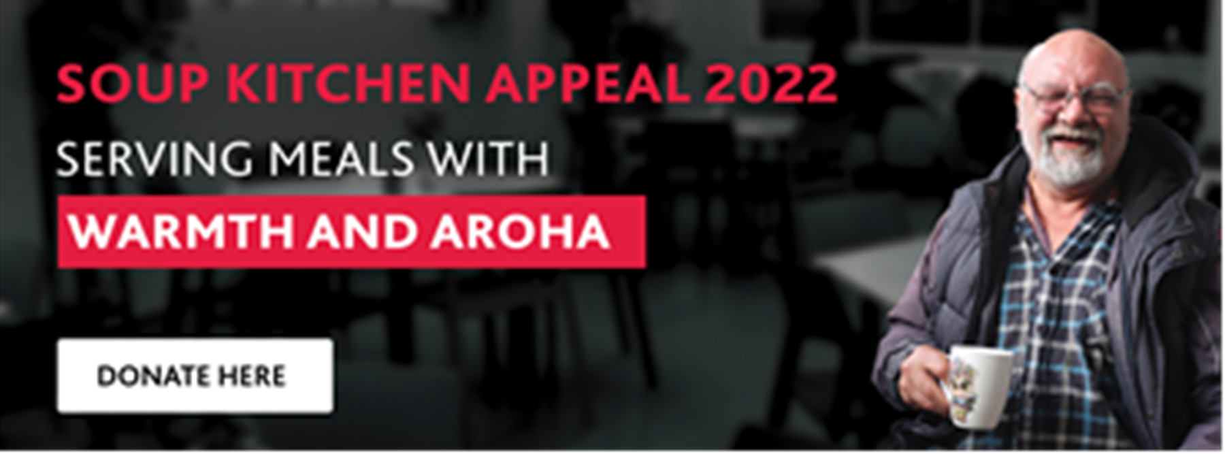
Encountering the poor enables us to put an end to many of our anxieties and empty fears, and to arrive at what truly matters in life, the treasure that no one can steal from us: true and gratuitous love. The poor, before being the object of our almsgiving, are people, who can help set us free from the snares of anxiety and superficiality.

Slide 21
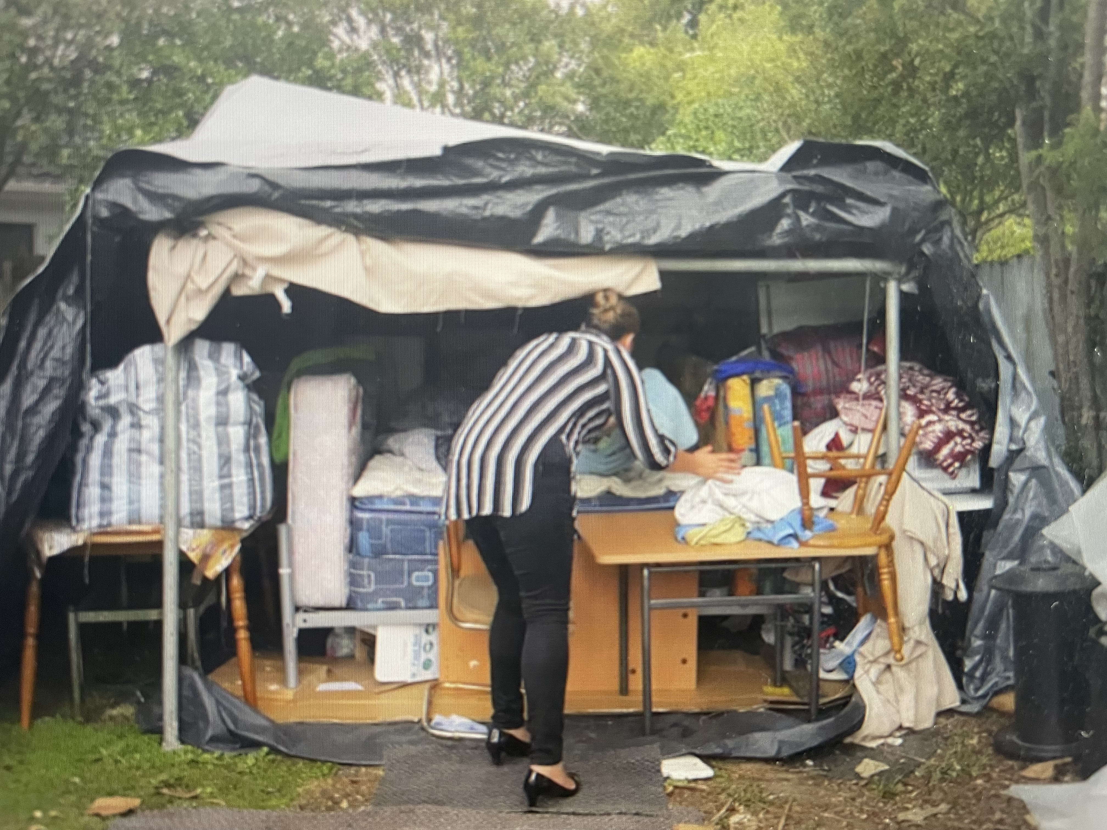
Because Christ became poor for our sakes, our own lives are illumined and transformed, and take on a worth that the world does not appreciate and cannot bestow

Slide 22
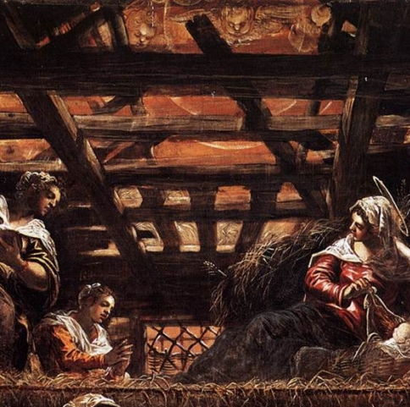
May this 2022 World Day of the Poor be for us a moment of grace. May it enable us to make a personal and communal examination of conscience and to ask ourselves whether the poverty of Jesus Christ is our faithful companion in life

